Slide 1

MICRO CREDIT DEFAULT ANALYSIS

Slide 2
Business Problem Framing
Data source- Telecom Company
Product offered- micro credits for subscribers
Risk attached- possible defaults in credit loans repayment
Binary Classification problem to predict the defaulters using Machine learning algorithm

Slide 3



Background of Domain Problem
Micro credit loans to poor and low-income users
Loan to be repaid in 5 days
Tariffs- 1 Indonesian rupiah on amount of 5
Defaulter- T+5 days
Lack of predictability of financial repayment
No financial history of poor

Slide 4

Motivation of the problem
Loan defaulters- risk to the company
Raw data of users with the telecom company
Machine learning model - predict defaulters using raw data
Risk minimization for the company

Slide 5

Mathematical/analytical modelling
Negative entries in few features
Presence of outliers
Few redundant features
Imbalanced label class

Slide 6
Data sources and their formats
2,09,593 users
Dependent feature
0- Defaulter
1-Non-Defaulter
36 Independent feature
User’s recharge and rental information
Data
Classification
Information

Slide 7
Data sources and their formats
Null- Values
Data types
Int
Label
Binary feature
Imbalan--ced Dataset
88% non-defaulter data
Float
object
12% defaulter’s data
No null-values in dataset
Value – 0 or 1

Slide 8

Data preprocessing
CLEANING
Unrealistic negative values treated with absolute func.
REDUCTION
Redundant features: Unnamed 0:, pcircle dropped.
TRANSFORM
Normalization of data with MinMaxScaler
outliers removed.
skewness treated

Slide 9

Hardware software tools Required
Processor- Intel(R) Core(TM) i5-10210U CPU @ 1.60GHz 2.11 GHz
RAM-8.00 GB
Edition-Windows10
Libraries- Pandas, Seaborn, Matplotlib.pyplot, Warning,
Sklearn
Packages- Power Transformer, Min Max Scaler,
SMOTE Tomek, train test split, Cross Val Score,
Grid Search CV, Metrics.

Slide 10
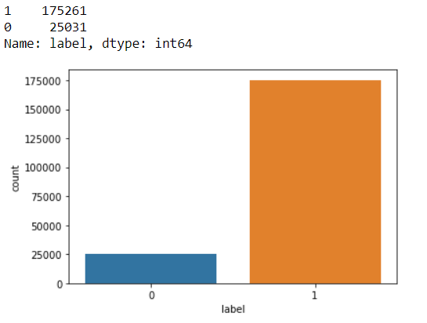
visualization
Label i.e. the feature to be predicted is highly imbalanced with 175261 observations for entry 1 and 25,031 observations for entry 0.

Slide 11
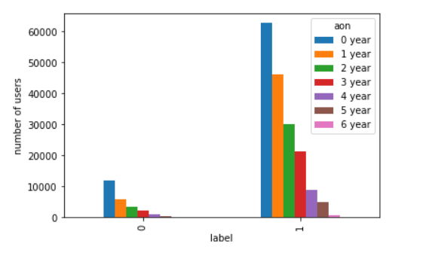
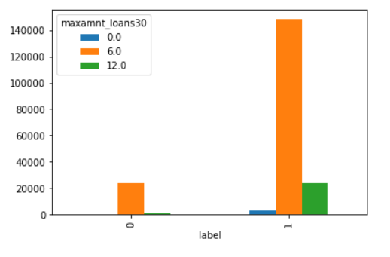
Visualization
Label v/s AON
Label v/s maxamnt_loans30
Mostly users are new to the network.
As aon increases the number of users decreases.
13% of the users who took a maximum loan of 6 are defaulters.
4% of those who have taken maximum credit of 12 are defaulters

Slide 12

Model development and evaluation
Data Imbalance
SMOTETomek used to handle data imbalane
Splitting label
train_test_split used to separate input and output features.
Algorithms and optimization
Four models used- Logistic regression, SVC, DTC, Random forest classifier.
Parameter optimized with GridSearchCV

Slide 13
Model development and evaluation
Score of models
Logistic Regression: 0.772
SVC: 0.865
Decision Tree Classifier: 0.917
Random Forest Classifier: 0.952

Slide 14

Metrics used
Confusion metrics
Classification report
AUC-ROC curve

Slide 15
Confusion Metrics:
Random Forest Classifier
Logistic Regression
Support Vector Classifier
Decision Tree Classiifer

Slide 16
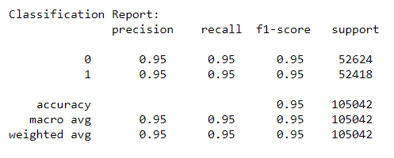
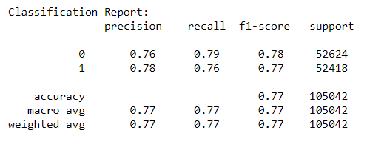
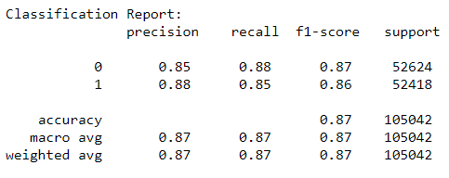
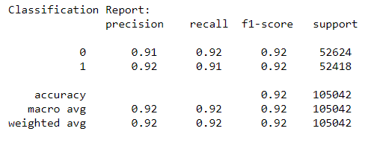
Classification report:
Random forest classifier
Logistic Regression
Support Vector Classifier
Decision Tree Classifier

Slide 17
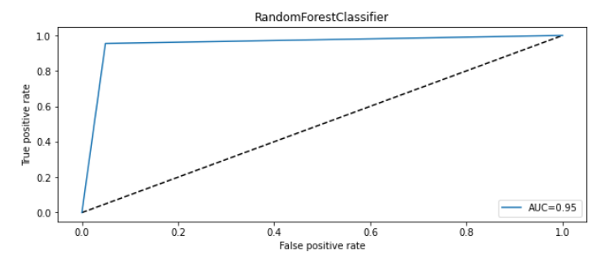
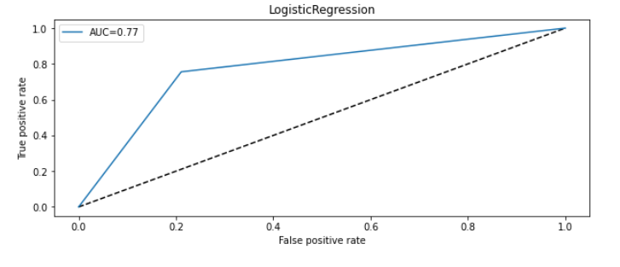
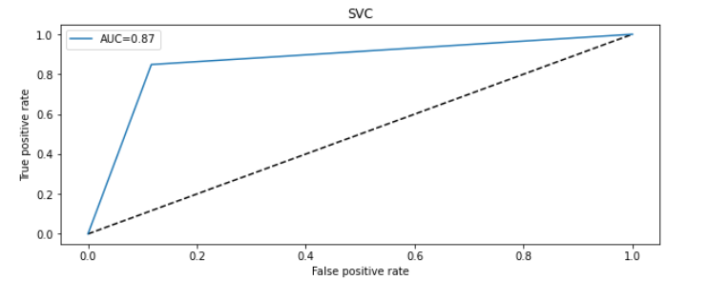
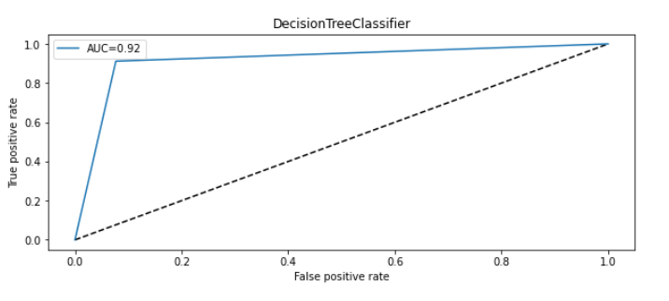
Auc-Roc curve:
Random forest classifier:
Logistic regression:
Support vector classifier:
Decision tree classifier:

Slide 18
Interpretation of the result
Random Forest is performing at 95.28% accuracy, F1 score of 95.28.

Slide 19
conclusion
Random forest is the best estimator of the binary classification problem of predicting defaulters.
Random forest is a bagging classifier which enhances the score of the base classifier.
Random forest is an ensemble classifier so it does not overfit.

Slide 20
Limitations and Scope of future work
Scope of future work
Extend products with other financial institutions
Credit score linkage of users
Classify users into categories based on financial histories
Limitations
Same number used by several users
Unavailability of credit scores of users

Slide 21
Thank you

